Slide 1

CREATivators: Web and Mobile Development for Advertisement 1.0
Team Members: Mikaila Daniel, Michael Quiros, Alejandro Thornton
Product Owner: Dr. Steven Rios
Mentors: Drs. Margo Berman and Francisco Ortega
Instructor: Dr. Masoud Sadjadi

Slide 2
Problem
Members currently use traditional communication methods such as e-mail and phone.
No dedicated repository of information about the Positive Pathways Program (PPP).
Agendas and minutes of monthly meetings are not centralized.

Slide 3
Solution
Dedicated mobile application for communication and information.
Pages dedicated to the programs, members, partners, and other information about PPP.
Agendas of future monthly meetings and minutes of past meetings collected in one location.

Slide 4
Requirements
General users can view profiles, programs, partners, and training materials without an account.
With an account, Members can edit their individual profile pages as well as their respective program pages.
Additionally, Members can view and edit meeting agendas and minutes.

Slide 5
Implementation
MongoDB for database organization.
Mongoose for database operations.
mLab for remote database hosting.
Express for routing requests and responses to/from server.
NodeJS for server operations.
JSON Web Token for encrypting and decrypting tokens.

Slide 6
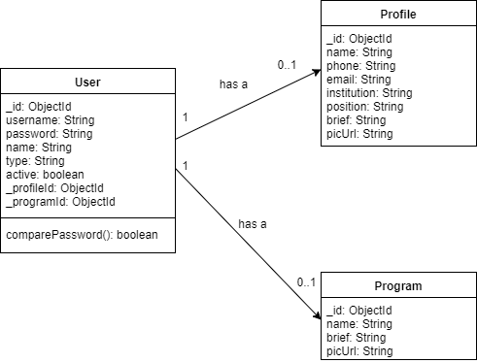
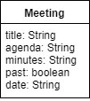
Object Design
Class Diagrams for User, Profile, Program and Meeting objects.

Slide 7
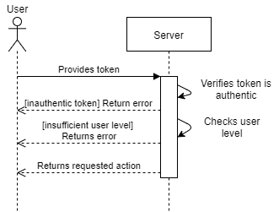
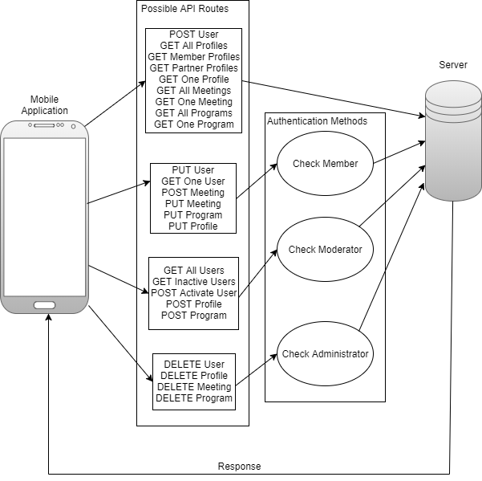
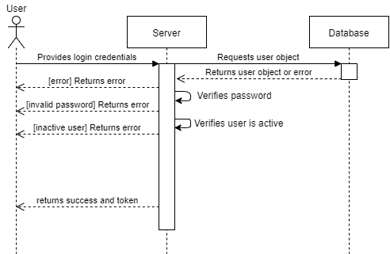
System Design
Token Verification Sequence Diagram
User Authentication Sequence Diagram
Authentication / Token Verification Design

Slide 8
User Stories
Sprints | Completed User Stories
2 | #666: Server Setup
3 | #670: Create Profile Model #671: Create Profile API Routes #676: Create Main Menu Page
4 | #678: Testing Calls to the Database #681: Create Meeting Model #683: Create Meeting API Routes #684: Create User Authentication Structure #688: User Authentication #690: Token Verification
5 | #682: View Meetings #685: Create Program Model #686: Create Program API Routes
6 | #680: Create New Meeting #691: View Member Profile #692: Log onto Server from Application #693: Search by Name or University #694: Edit Meeting #695: Edit Profile

Slide 9
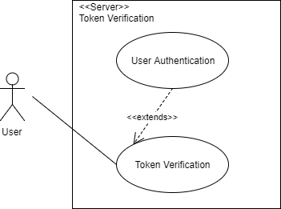
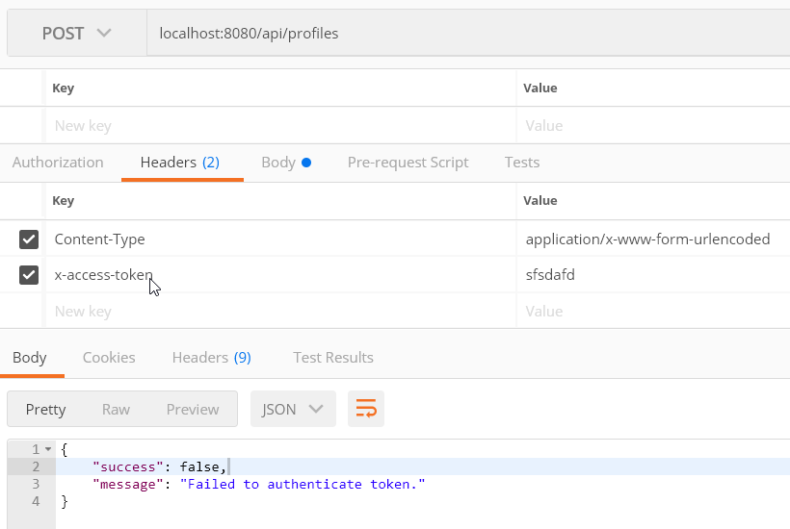
Example User Story 1: #690: Token Verification
Use Case Name | Token Verification
Participating Actors | User, Server
Entry Condition | 1. User provides token to Server.
Flow of Events | 2. Server verifies token authenticity using predefined secret phrase. If token is not authentic: 2.1. Go to step X. If token is authentic: 2.2. Go to step 3. 3. Server checks the user level contained within the token. If the user level is insufficient for the requested action: 3.1. Go to step X. If the user level is sufficient for the requested action: 3.2. Go to step 4.
Exit Condition | 4. Server either allows or prevents access. If token does not meet requirements for access: 4.1. Server returns error message. If token does meet requirements for access: 4.2. Server continues with requested action.

Slide 10
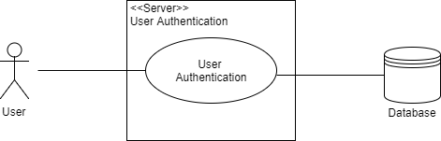
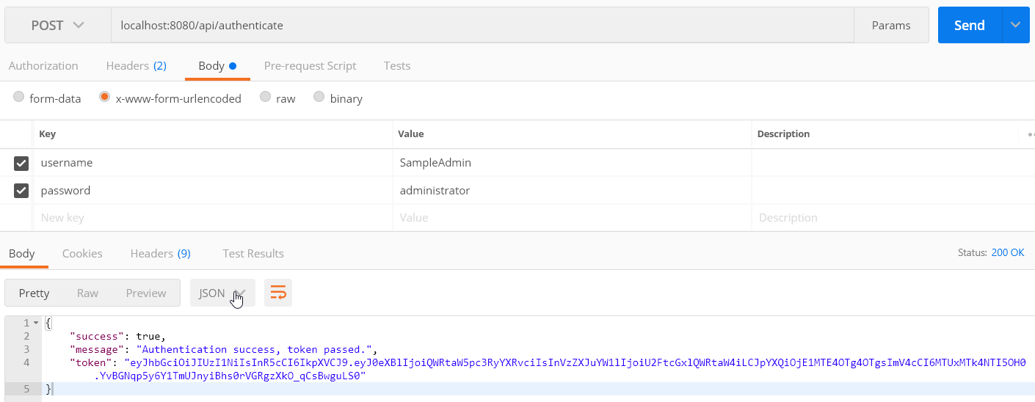
Example User Story 2: #688: User Authentication
Use Case Name | User Authentication
Participating Actors | User, Server, Database
Entry Condition | 1. User provides credentials to Server.
Flow of Events | 2. Server verifies that the username exists in the Database. If username does not exist in the Database: 3.1. Go to step 5.2. If username does exist in the Database: 3.2. Go to step 3. 3. Server verifies the provided password matches the password of the account associated with the username in the Database. If the passwords do not match: 4.1: Go to step 5.2. If the passwords do match: 4.2: Go to step 4. 4. Server verifies that the account is currently active. If the account is not active: 5.1: Go to step 5.2. If the account is active: 5.2: Go to step 5.1.
Exit Condition | 5. Server returns response to User. If credentials were successfully authenticated: 6.1. Server returns success message and token to User. If credentials were not successfully authenticated: 6.2. Server returns error message to User.

Slide 11
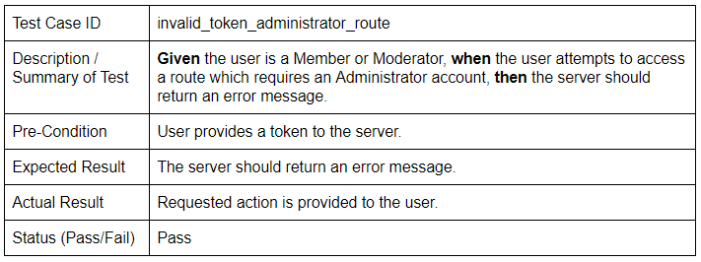
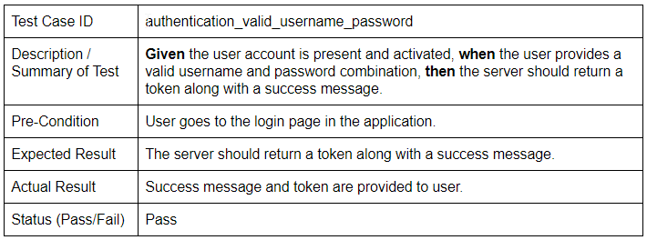
Verification (Example Test Cases)

Slide 12
Summary
General users may find information about Positive Pathways’ programs, partners, members and meetings.
Members may edit their profiles, programs, and meetings.
Application data guarded against tampering through user authentication system.

